Slide 1



Paediatric
Daily Fluid Prescription & Balance Chart
2017

Slide 2
This presentation applies to
children and young people
aged over 4 weeks and
under 16 years of age.

Slide 3
Aims and outcomes of session.
Aim:
To provide guidance on correctly completing the
Outcomes:
Demonstrate the ability to:
calculate and complete fluid prescription.
correctly administer fluids.
correctly complete a fluid balance chart.
paediatric
daily fluid prescription & balance chart.

Slide 4

NPSA alert 22

Slide 5
Front

Slide 6
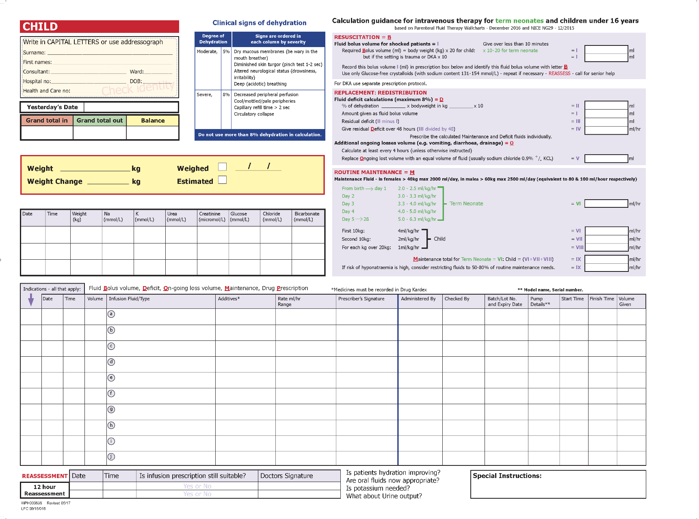
Back

Slide 7
Chart must be used for children aged
from birth up to their 16th birthday,
throughout each of the 5 HSC Trusts,
wherever their care is provided,
except for Neonates and children,
  cared for in ICUs, HDUs, specialist wards or units; or
  with diabetic ketoacidosis; or
  with acute burns,
  who may use different fluid prescription charts.

Slide 8
For information on
Preparing Chart
Prescribing fluids
Administering fluids
Prescribing medicines
Completing fluid balance chart
Recording intake
Recording output
Recording balance
Start next days chart
slide 8
slide 12
slide 26
slide 28
slide 33
slide 33
slide 41
slide 48
slide 53

Slide 9
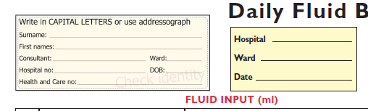
1. Labelling
Front
and
Back
Stick on labels on both sides of chart, and
Complete hospital, ward & date.
Minimum patient identifiers are:
Full Name
DOB
Hospital number

Slide 10

2. Insert patient’s weight in kgs
The weight used must be a recent weight
Indicate whether measured & when
or only estimated

Slide 11
3. Complete previous days fluid volumes

Slide 12
4. Prescribe fluids - evidence

Slide 13
4. Prescribe fluids - evidence
The 5Rs
Reassessment
Resuscitation
Replacement :
Redistribution
Routine Maintenance

Slide 14
4. Prescribe fluids - evidence
Shock → Fluid Bolus
Correct Deficit
Ongoing fluid losses
Maintenance

Slide 15
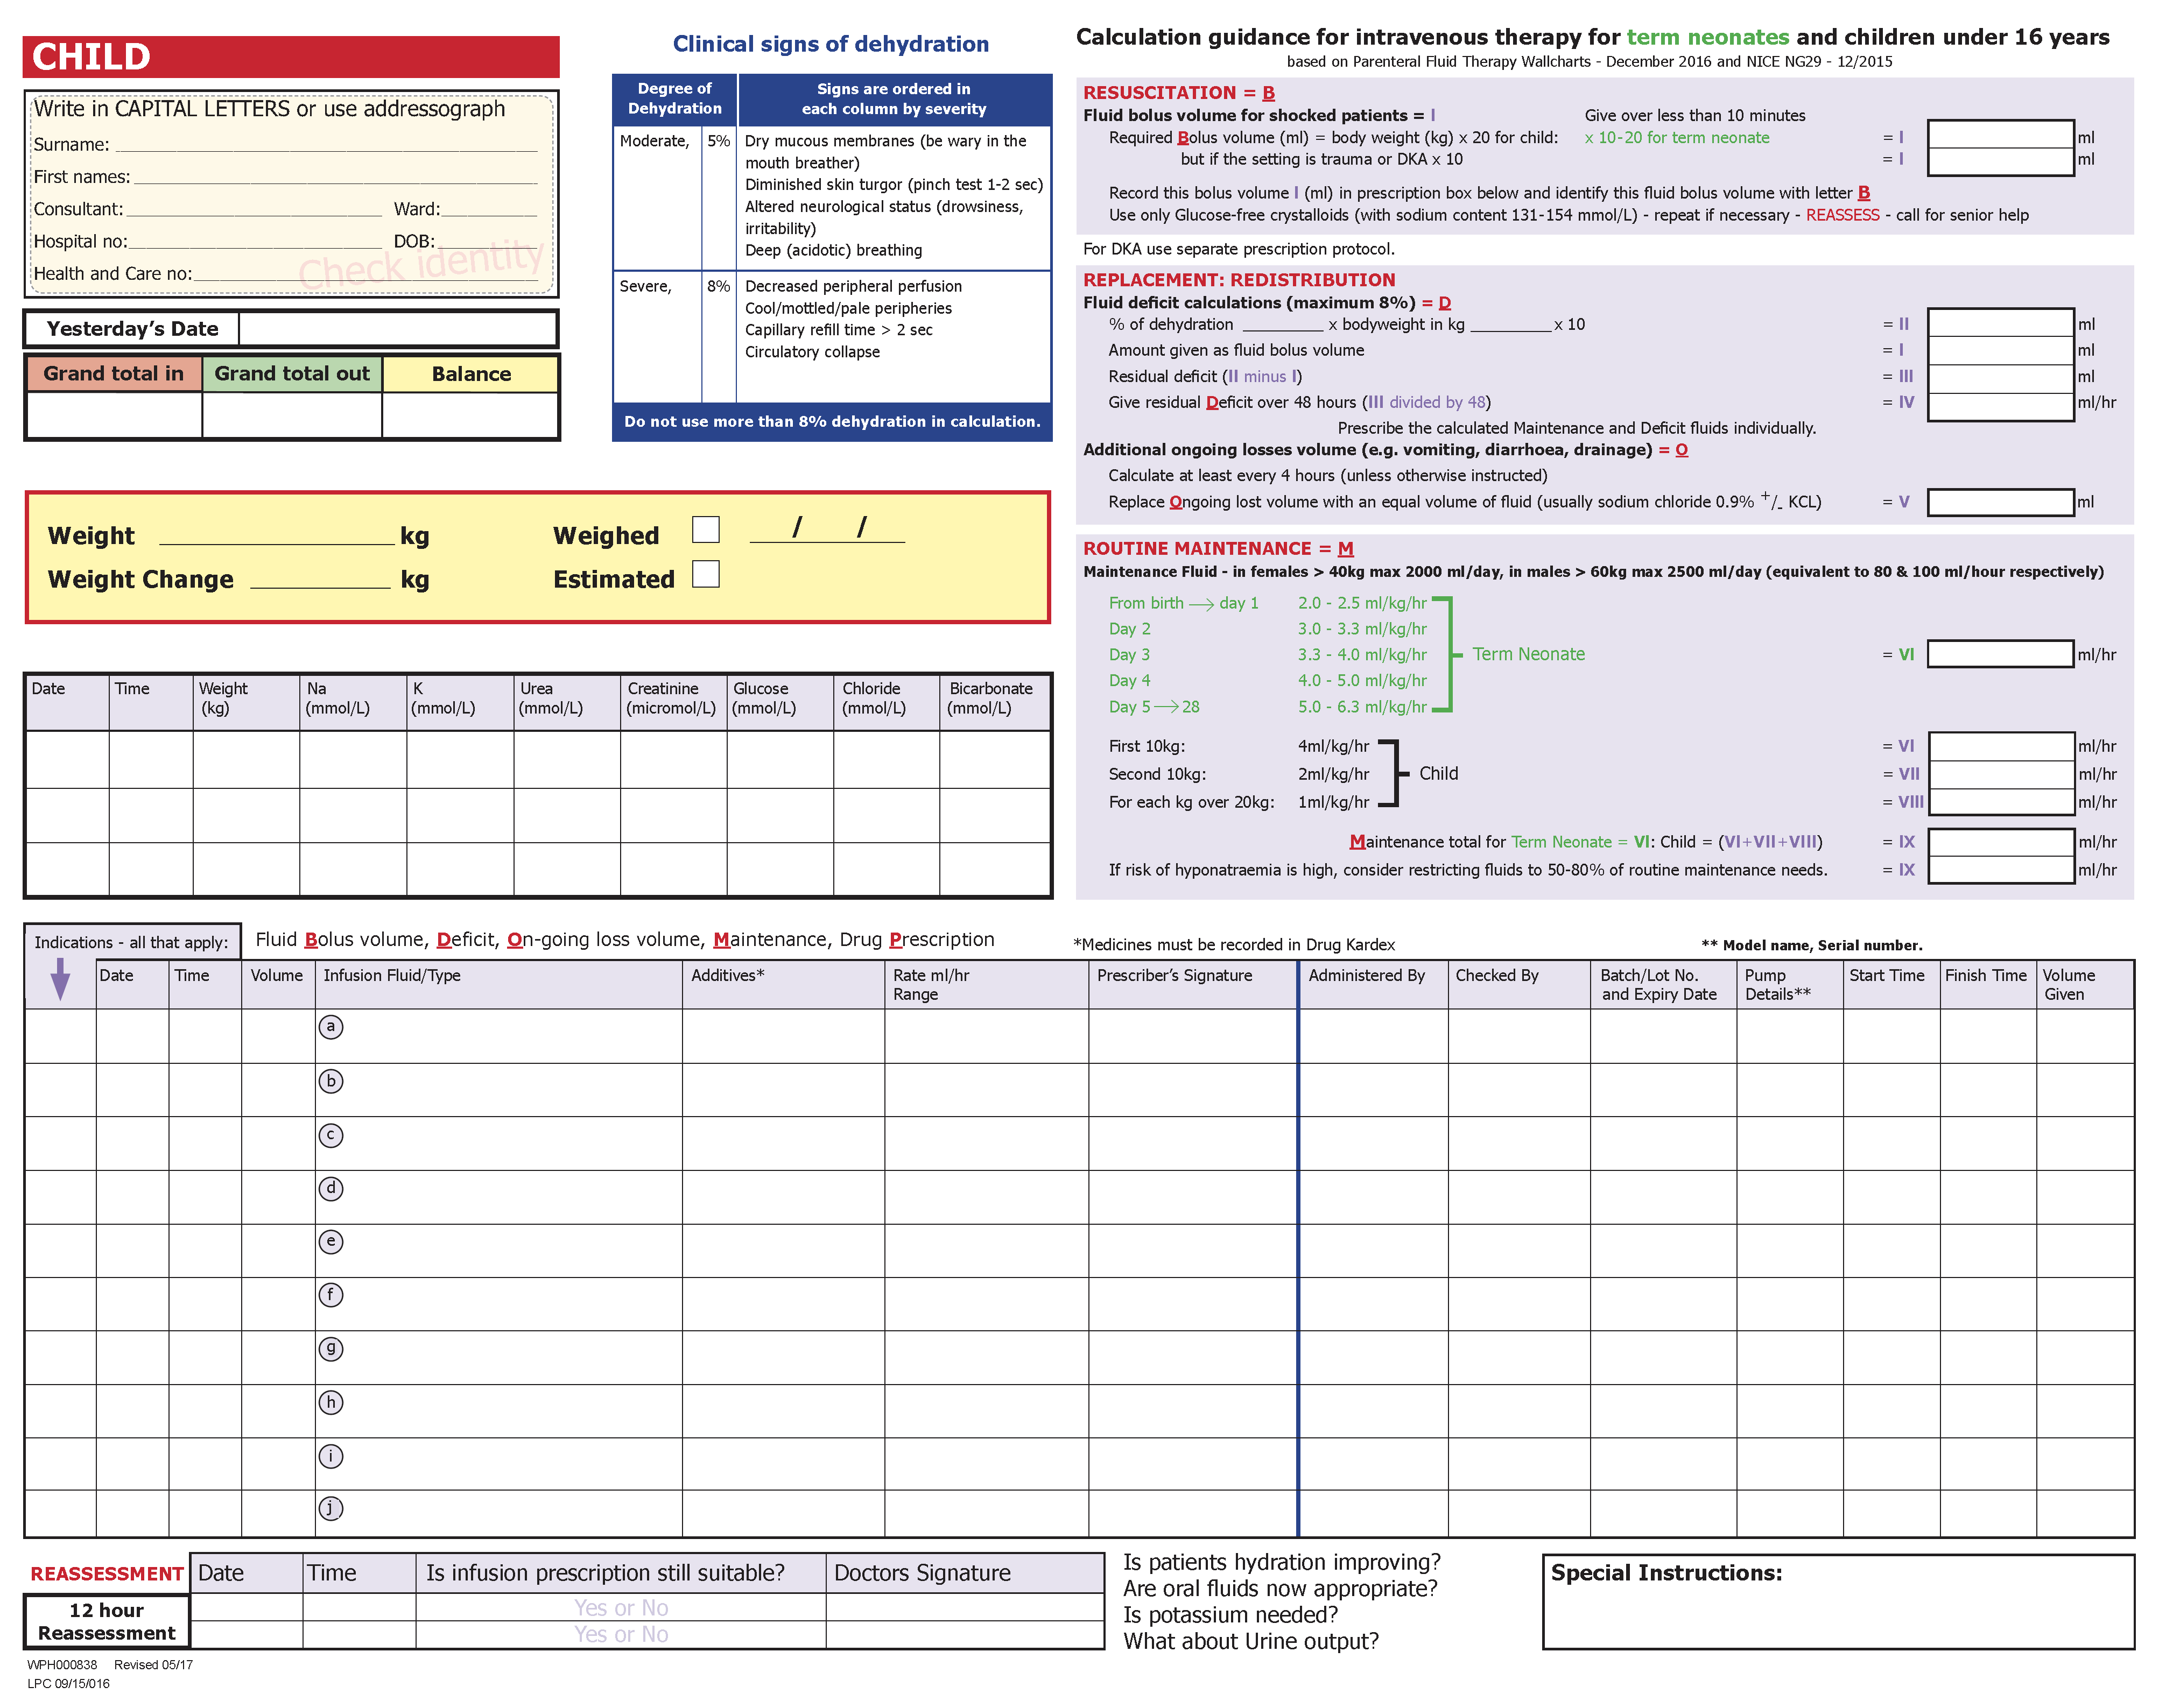
4. Prescribe fluids - method
Shock → Fluid Bolus
Correct Deficit
Ongoing fluid losses
Maintenance

Slide 16
4. Prescribe fluids - method
Shock → Fluid Bolus
Correct Deficit
Ongoing fluid losses
Maintenance

Slide 17
4. Prescribe fluids - method
Shock → Fluid Bolus
If fluid Bolus required →
calculate volume
prescribe this calculated volume
record indication as
B
B
B
B
Over 15 minutes
B
01/01/xxxx
12:00
540 mls
0.9% SODIUM CHLORIDE

Slide 18
4. Prescribe fluids - method
Shock → Fluid Bolus
Correct Deficit
Is there a fluid Deficit?
    calculate correction
    prescribe
    record indication as D

Slide 19
4. Prescribe fluids - method
Shock → Fluid Bolus
Correct Deficit
B
01/01/xxxx
12:00
540 mls
0.9% SODIUM CHLORIDE
Over 15 minutes
D
01/01/xxxx
12:30
500mls
0.9% SODIUM CHLORIDE

Slide 20
4. Prescribe fluids - method
Shock → Fluid Bolus
Correct Deficit
Ongoing fluid losses
If there are any Ongoing losses
calculate
prescribe
record indication as O

Slide 21
4. Prescribe fluids - method
Shock → Fluid Bolus
Correct Deficit
Ongoing fluid losses
B
01/01/xxxx
12:00
540 mls
0.9% SODIUM CHLORIDE
Over 15 minutes
D
01/01/xxxx
12:30
500mls
0.9% SODIUM CHLORIDE
O
01/01/xxxx
17:00
164mls
0.9% SODIUM CHLORIDE with
Potassium Chloride 10 mmoL (500ml bag)

Slide 22
4. Prescribe fluids - method
Shock → Fluid Bolus
Correct Deficit
Ongoing fluid losses
Maintenance
Calculate Maintenance requirements
  record indication as M

Slide 23
4. Prescribe fluids - method
Shock → Fluid Bolus
Correct Deficit
Ongoing fluid losses
M
Maintenance
B
01/01/xxxx
12:00
540 mls
0.9% SODIUM CHLORIDE
Over 15 minutes
D
01/01/xxxx
12:30
500mls
0.9% SODIUM CHLORIDE
O
01/01/xxxx
17:00
164mls
0.9% SODIUM CHLORIDE with
Potassium Chloride 10 mmoL (500ml bag)
M
01/01/xxxx
12.30
500mls
HARTMANN’S SOLUTION

Slide 24
4. Prescribe fluids - example
B
01/01/xx
12:00
540 mls
0.9% SODIUM CHLORIDE
Over 15 minutes
Xxxx. Xxxxx
M
01/01/xx
1230
500 mls
HARTMANN’S SOLUTION
67 mls/hr
Xxxx. Xxxxx
O
01/01/xx
1700
164 mls
0.9% SODIUM CHLORIDE with
Potassium Chloride 10 mmoL (500ml bag)
41 mls/hr
Xxxx. Xxxxx
Example 1:
Based on 27 kg child.
Appendicitis.
Initially treated for shock.
164 mls gastric losses over 4 hour period.
Plasma glucose = normal.

Slide 25
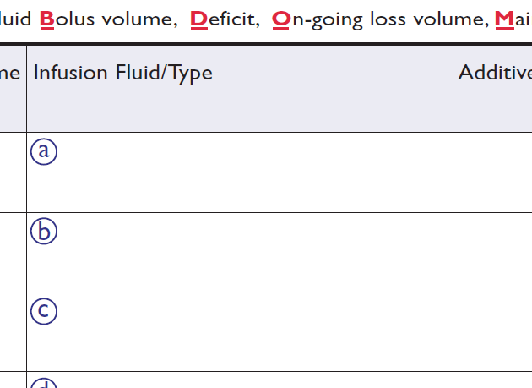



4. Prescribe fluids - identification
0.9% SODIUM CHLORIDE
HARTMANN’S SOLUTION
0.45%SOD. CHL. + 2.5% GLUCOSE
Infusion fluids can also be identified by their Letter

Slide 26
4. Fluid prescription & administration
IV fluid infusions
  Intravenous fluid replacement or treatment.
  e.g. Sodium Chloride 0.9%, Hartmann’s Solution.
Prescribe on back of Fluid Chart
Record volumes on front of Fluid Chart
Not necessary to prescribe or reference on Kardex.
Hartmenns Soln.
20
20
20
20
20
20
20
20
20
20
20
20
20
Sod Chloride 0.9%
40
40
40
40
40
40
40
40
40
40

Slide 27
4. Administration
B
01/01/xx
12:00
540 mls
0.9% SODIUM CHLORIDE
Over 15 minutes
Xxxx. Xxxxx
M
01/01/xx
1230
500 mls
HARTMANN’S SOLUTION
67 mls/hr
Xxxx. Xxxxx
O
01/01/xx
1700
164 mls
0.9% SODIUM CHLORIDE with
Potassium Chloride 10 mmoL (500ml bag)
41 mls/hr
Xxxx. Xxxxx
When completing this section, the following double checks are made:-
Correct patient
Correct fluid or medicine
Correct dose
Correct time
Correct route
Check
- including Batch number & Expiry date
Infusion pump details

Slide 28
5. Medicine prescription & administration
Intermittent infusions
  administration of an
  infusion over a set time period,
  either as a one-off dose,
  or
  repeated at specific time intervals,
  e.g. pre-prepared infusion – paracetamol, ciprofloxacin, metronidazole.
Prescribe on Kardex
Record volumes on front of Fluid Chart
Not necessary to record on back of Chart
PARACETAMOL
100
CIPROFLOXACIN
200
CIPROFLOXACIN
200
PARACETAMOL
100

Slide 29
5. Medicine prescription & administration
NG tube
20G
Right hand
20G
Left hand
20G
Left ACF
If feasible
Record all IV drugs (e.g. paracetamol or antibiotics) in one column
e.g. column indicated
enables calculation of daily medicines volume.
PARACETAMOL
100
CIPROFLOXACIN
200
CIPROFLOXACIN
200
PARACETAMOL
100
600

Slide 30
5. Medicine prescription & administration
Intermittent infusions
  All fluid volumes must be recorded
  on the front
  of the Fluid Chart.
Unless,
  Clinical team advises otherwise
  Ward/unit protocol states otherwise.
  e.g. Young person over 50kg. receiving small volume line flushes.

Slide 31
5. Medicine prescription & administration
Continuous infusions
  administration of a volume of fluid with medicines added
  e.g. Amiodarone in 5% Glucose infusion.
Reference on Kardex
Record volumes on front of Fluid Chart
Prescribe on back of Fluid Chart
Glucose 5% +
Amiodarone
20
20
20
20
20
20
20
20
20

Slide 32
5. Medicine prescription & administration
Electrolyte treatment
  administration of a fluid containing added electrolyte solution for replacement or treatment.
  e.g. Potassium, Phosphate, Magnesium.
Reference on Kardex
Record volumes on front of Fluid Chart
Prescribe on back of Fluid Chart
Sodium Chloride 0.9%
10 mmoL KCl
20
20
20
20
20
20
20
Magnesium S.
20
100
20
20
20
20
20

Slide 33
6. Record Intake
NG tube
20G
Right hand
20G
Left hand
Record
  Site
  Type of fluid
  Amount received
  Total volume
for each type of fluid
every hour

Slide 34
6. Record Intake
NG tube
20G
Right hand
20G
Left hand
Record
  Site
  Type of fluid
  Amount received
  Total volume
for each type of fluid
every hour
20
Ensure
20
0.9% Sodium Chloride
20
50
20
50
20
50
20
50
20
50
20
Hartmann’s
20
20
20
20
0.45% Sod Chl + 2.5% Glucose
20
20
50
20
50
20
50
20
50
20
50
20
20
20
20
20
20
20

Slide 35
6. Record Intake
NG tube
20G
Right hand
20G
Left hand
Record
  Site
  Type of fluid
  Amount received
  Total volume
for each type of fluid
every hour
20
Ensure
20
ⓐ
*
20
50
20
50
20
50
20
50
20
50
20
ⓑ
20
20
ⓒ
20
20
20
20
50
20
50
20
50
20
50
20
50
20
20
20
20
20
* = identify with letter if wish
20
20

Slide 36
7. Intake – Cumulative total for each site
NG tube
20G
Right hand
20G
Left hand
Cumulative totals for
  each site
20
Ensure
20
ⓐ
20
50
20
50
20
50
20
50
20
50
20
ⓑ
20
20
ⓒ
20
20
20
20
50
20
50
20
50
20
50
20
50
20
20
20
20
20
20
20

Slide 37
7. Intake – Cumulative total for each site
NG tube
20G
Right hand
20G
Left hand
Cumulative totals for
  each site and
  possibly, each type of fluid.
20
Ensure
20
ⓐ
20
40
20
60
50
50
20
80
50
100
20
100
50
150
20
120
50
200
20
140
50
250
20
160
ⓑ
20
180
20
270
ⓒ
20
200
20
290
50
    can be totalled at the end of the day
    giving totals for each
      site
      type of fluid
20
220
20
310
50
20
330
50
100
20
350
50
150
20
370
50
200
20
390
50
250
20
410
20
430
20
450
20
470
20
490
20
510
20
530
220
530
250

Slide 38
8. Intake – Hourly cumulative totals
NG tube
20G
Right hand
20G
Left hand
Cumulative totals
to be calculated
  each hour
  to get an
  Hourly amount in
  and then
  Grand Total in
20
Ensure
20
ⓐ
20
40
20
60
50
50
20
80
50
100
20
100
50
150
20
120
50
200
20
140
50
250
20
160
ⓑ
20
180
20
270
ⓒ
20
200
20
290
50
20
220
20
310
50
20
330
50
100
20
350
50
150
20
370
50
200
20
390
50
250
20
410
20
430
20
450
20
470
20
490
20
510
20
530
220
530
250

Slide 39
8. Intake
NG tube
20G
Right hand
20G
Left hand
Worked example
  With cumulative totalling of
    Each hour
    And
    Each fluid
20
Ensure
20
20
20
ⓐ
20
40
20
40
20
60
50
50
70
110
20
80
50
100
70
180
20
100
50
150
70
250
20
120
50
200
70
320
20
140
50
250
70
390
20
160
ⓑ
20
410
20
180
20
270
ⓒ
40
450
20
200
20
290
40
490
20
220
20
310
50
50
90
580
20
330
50
100
70
650
20
350
50
150
70
720
20
370
50
200
70
790
20
390
50
250
70
860
20
410
20
880
20
430
20
900
20
450
20
920
20
470
20
940
20
490
20
960
20
510
20
980
20
530
20
1000
220
530
250

Slide 40
9. Record intake totals
200
20
220
290
490
780
1000
with Day & Night totals if requested by Senior Staff

Slide 41
10. Record outputs
Drain 1
Drain 2
Columns to record;
  Urine output,
  Output from Bowel,
  2 Spare columns,
  Comments column can also be used to record output, if needed.

Slide 42
10. Record outputs
N/G
Drain 1
Record
  Site if necessary
  Amount
  Type
for each type of fluid.
20
10
20
50
5
5
15
25
25
25
40
50
60
60
30
50
75
20
75
100
0
100
25
5
100

Slide 43
11. Output – Cumulative total for each fluid
N/G
Drain 1
Cumulative totals to be calculated for
  each type of fluid
20
10
20
50
5
5
15
25
25
25
40
50
60
60
30
50
75
20
75
100
0
100
25
5
100

Slide 44
11. Output – Cumulative total for each fluid
N/G
Drain 1
Cumulative totals to be calculated for
  each type of fluid
20
20
10
30
20
20
50
50
5
35
5
40
15
55
25
80
25
45
25
105
40
145
50
195
60
110
60
255
30
75
50
305
    can be totalled at the end of the day
    giving totals for each type of fluid
75
380
20
95
75
455
100
210
0
95
100
555
25
235
5
100
100
655
655
100
235

Slide 45
12. Output – Hourly Cumulative totals
N/G
Drain 1
Cumulative totals to be calculated for
  each hour
  to get an
  Hourly amount out
  and then
  Grand Total out
20
20
10
30
20
20
50
50
5
35
5
40
15
55
25
80
25
45
25
105
40
145
50
195
60
110
60
255
30
75
50
305
75
380
20
95
75
455
100
210
0
95
100
555
25
235
5
100
100
655
655
100
235

Slide 46
12. Output – Hourly Cumulative totals
N/G
Drain 1
Cumulative totals to be calculated for
  each hour
  to get an
  Hourly amount out
  and then
  Grand Total out
20
20
20
20
10
30
20
20
50
50
80
100
5
35
5
105
5
40
5
110
15
55
15
125
25
80
25
45
50
175
25
105
25
200
40
145
40
240
50
195
60
110
110
350
60
255
30
75
90
440
50
305
50
490
75
380
75
565
20
95
20
585
75
455
100
210
175
760
0
95
100
555
25
235
125
885
5
100
5
890
100
655
100
990
655
100
235

Slide 47
13. Record output totals
380
275
655
75
25
100
110
125
235
990
with Day & Night totals if requested by Senior Staff

Slide 48
14. Calculate overall hourly balance
Calculate the overall balance
  each hour
20
20
-20
80
100
-100
20
20
5
105
-85
20
40
5
110
-70
70
110
15
125
-15
70
180
50
175
5
70
250
25
200
50
70
320
40
240
80
70
390
110
350
40
20
410
90
440
-30
40
450
50
490
-40
75
40
490
565
-75
90
580
20
15
70
650
585
65
70
720
135
70
790
175
760
30
70
860
100
20
880
120
20
900
125
140
20
920
885
35
20
940
55
20
960
5
890
70
20
980
90
20
1000
100
990
10

Slide 49
15. Complete overall 24 hour balance
380
275
655
200
20
220
75
25
100
290
490
780
125
110
235
1000
990
+10
These boxes must be completed on every patient.
with Day & Night totals if requested by Senior Staff

Slide 50
16. Record Blood Glucose
Record Blood Glucose
when result available
Applies to
laboratory and near patient test results

Slide 51
17. Record Signature
Record signature or initials
when making entries onto chart

Slide 52
18. Complete 12 hour assessment
Complete 12 hour assessment
Consider questions

Slide 53
19. Start next day’s chart
i. Labelling
Front
Back
ii. Weight
iii. Volumes
1000
990
+10

